Slide 1
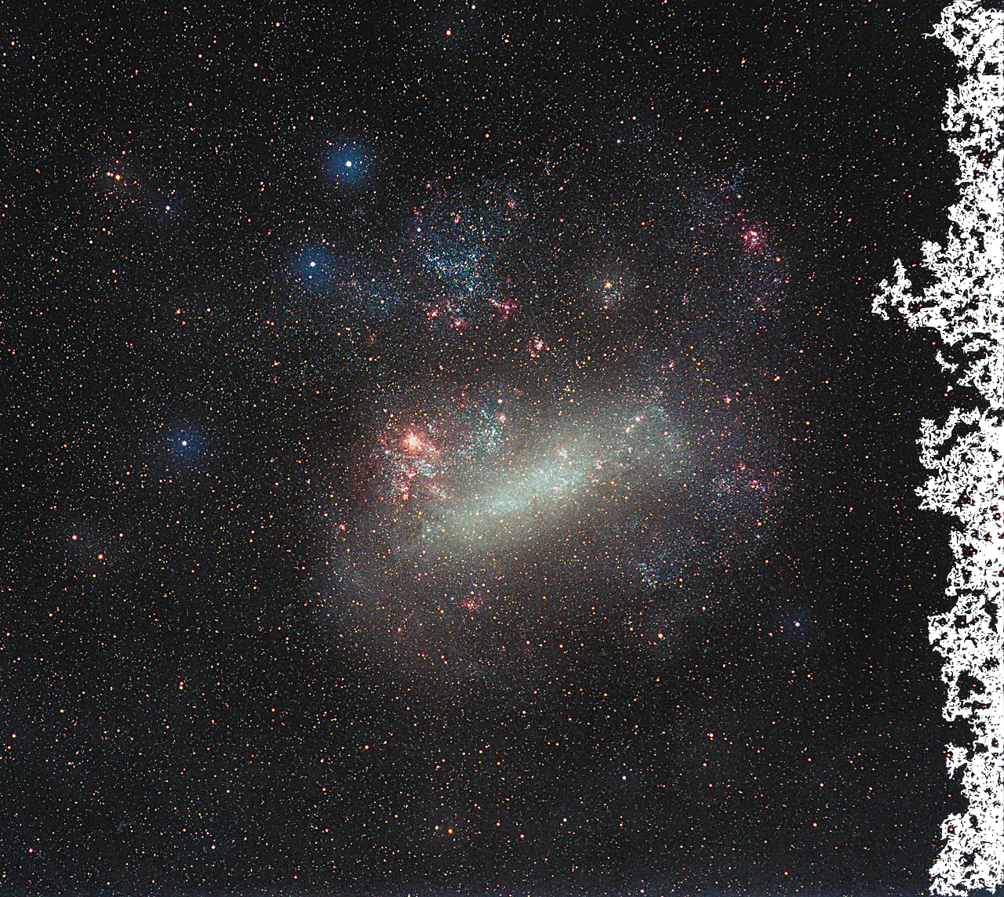
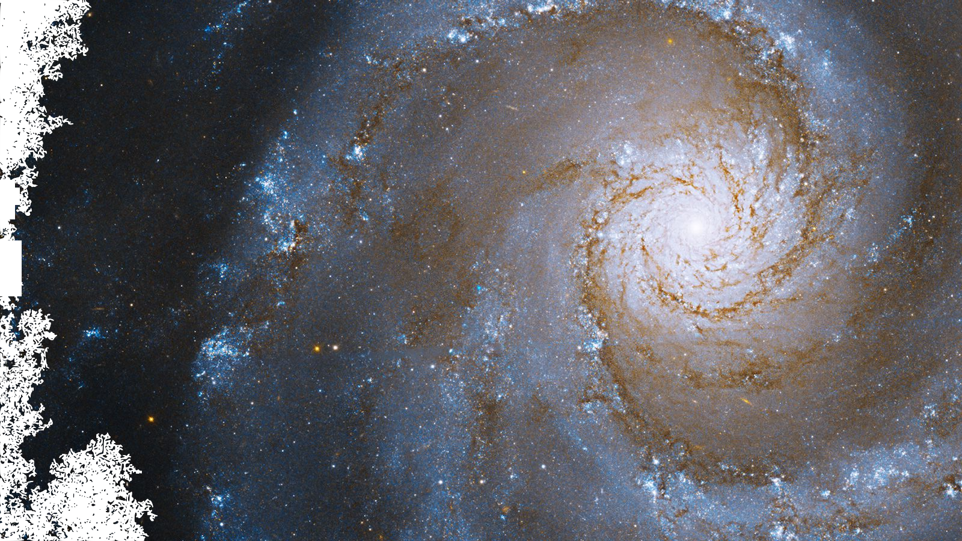
From Dwarfs to Spirals Chemical Evolution of Galaxies Across Stellar Mass and the Implications for Nucleosynthesis
James W. Johnson
The Ohio State University
PhD Defense
July 14, 2023

Slide 2
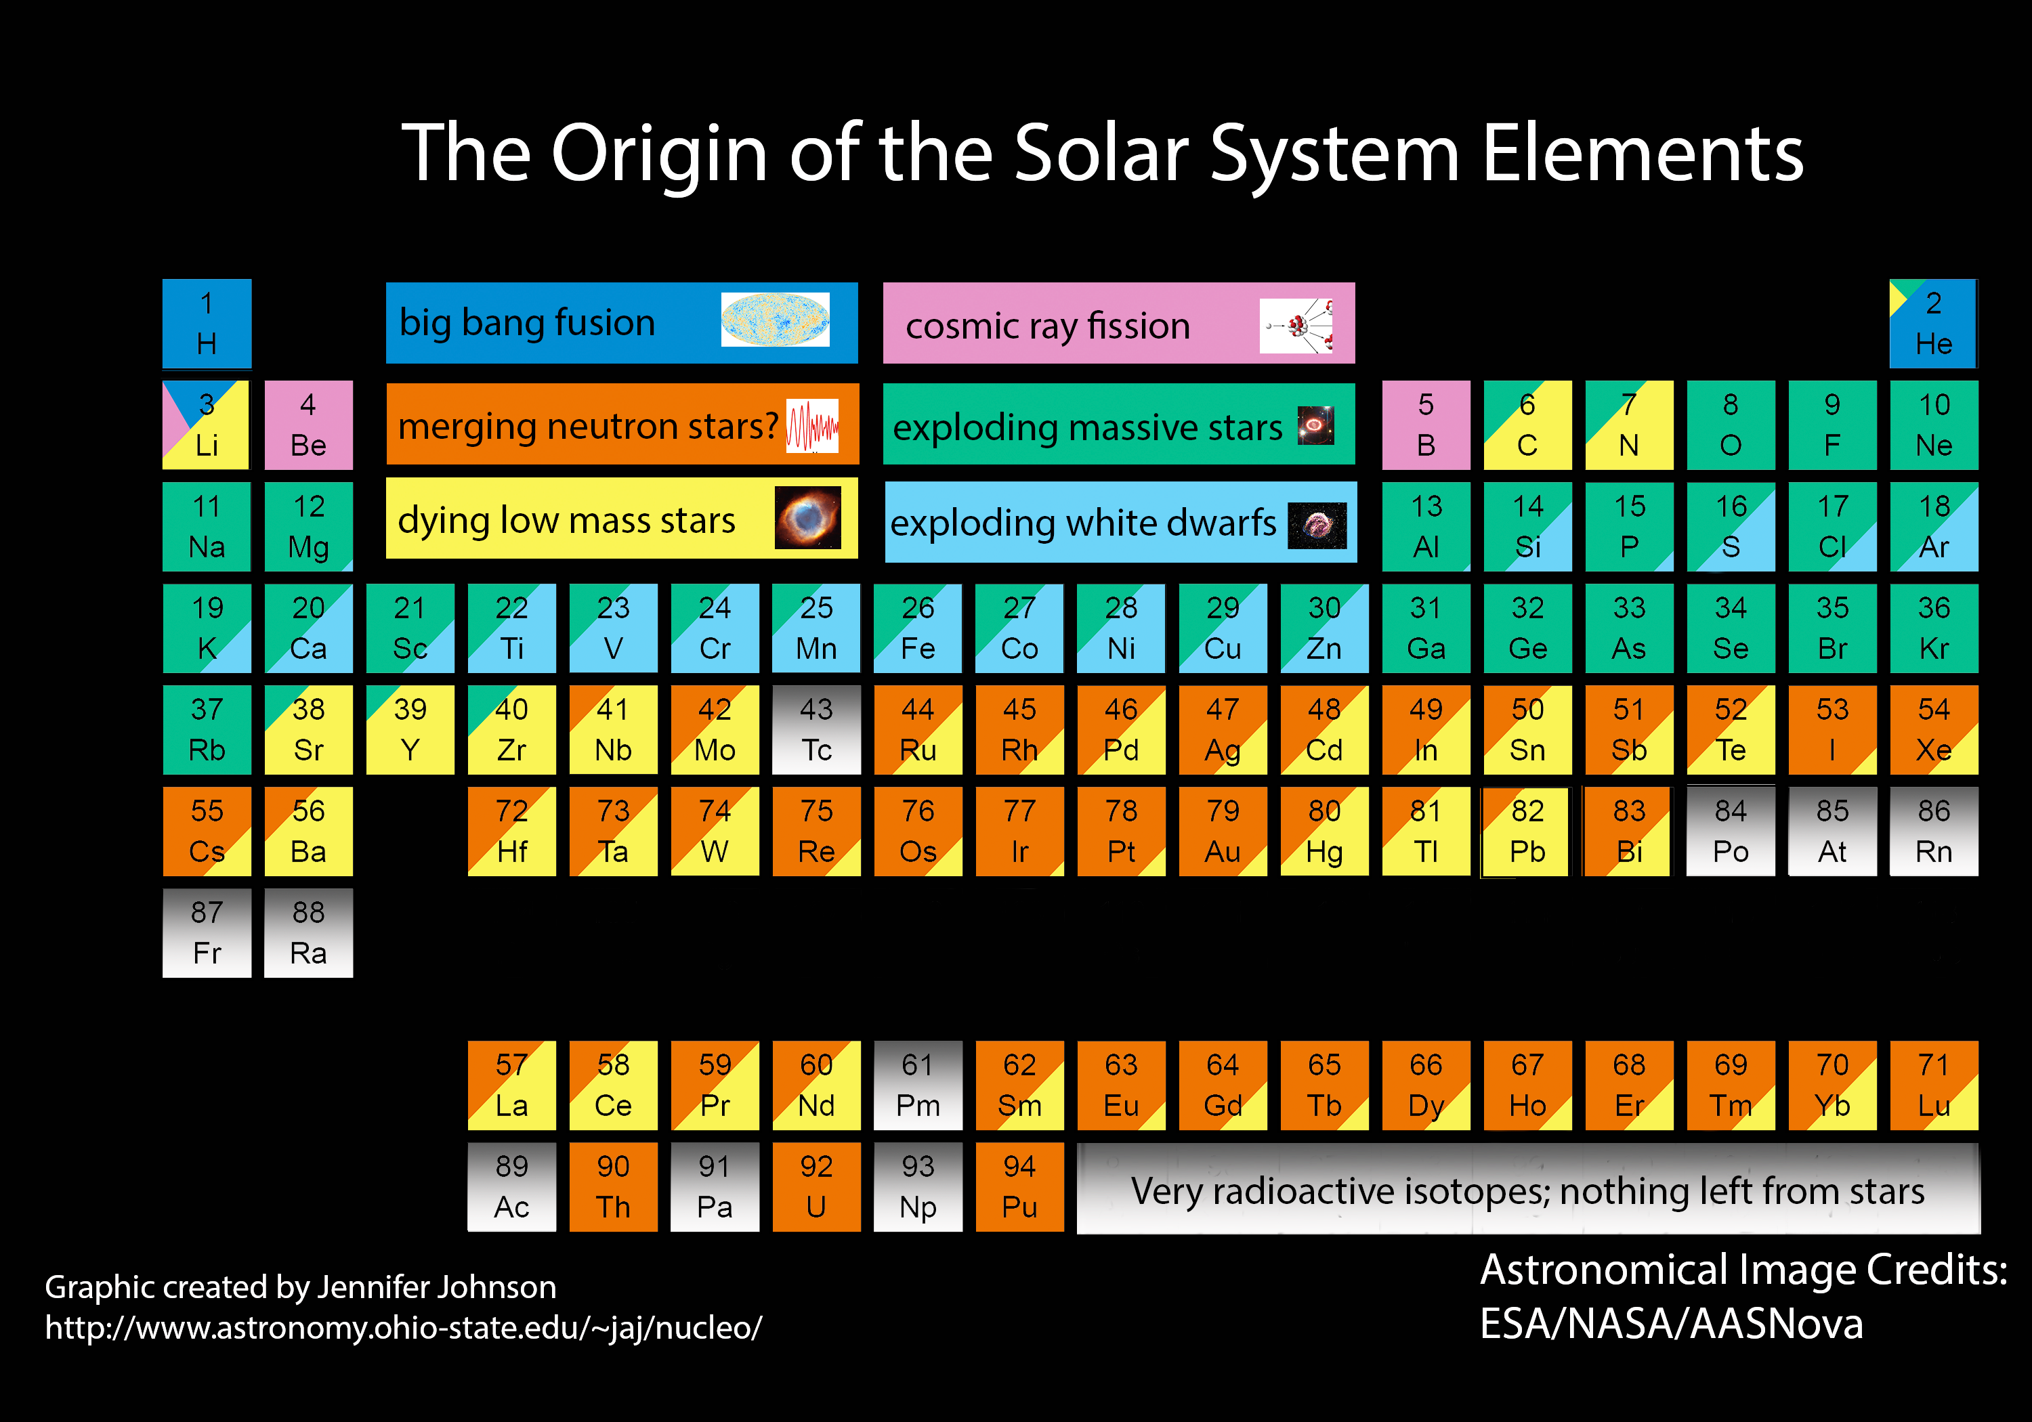
In the beginning, there was only H, He, and Li
Everything else was made in stars

Slide 3
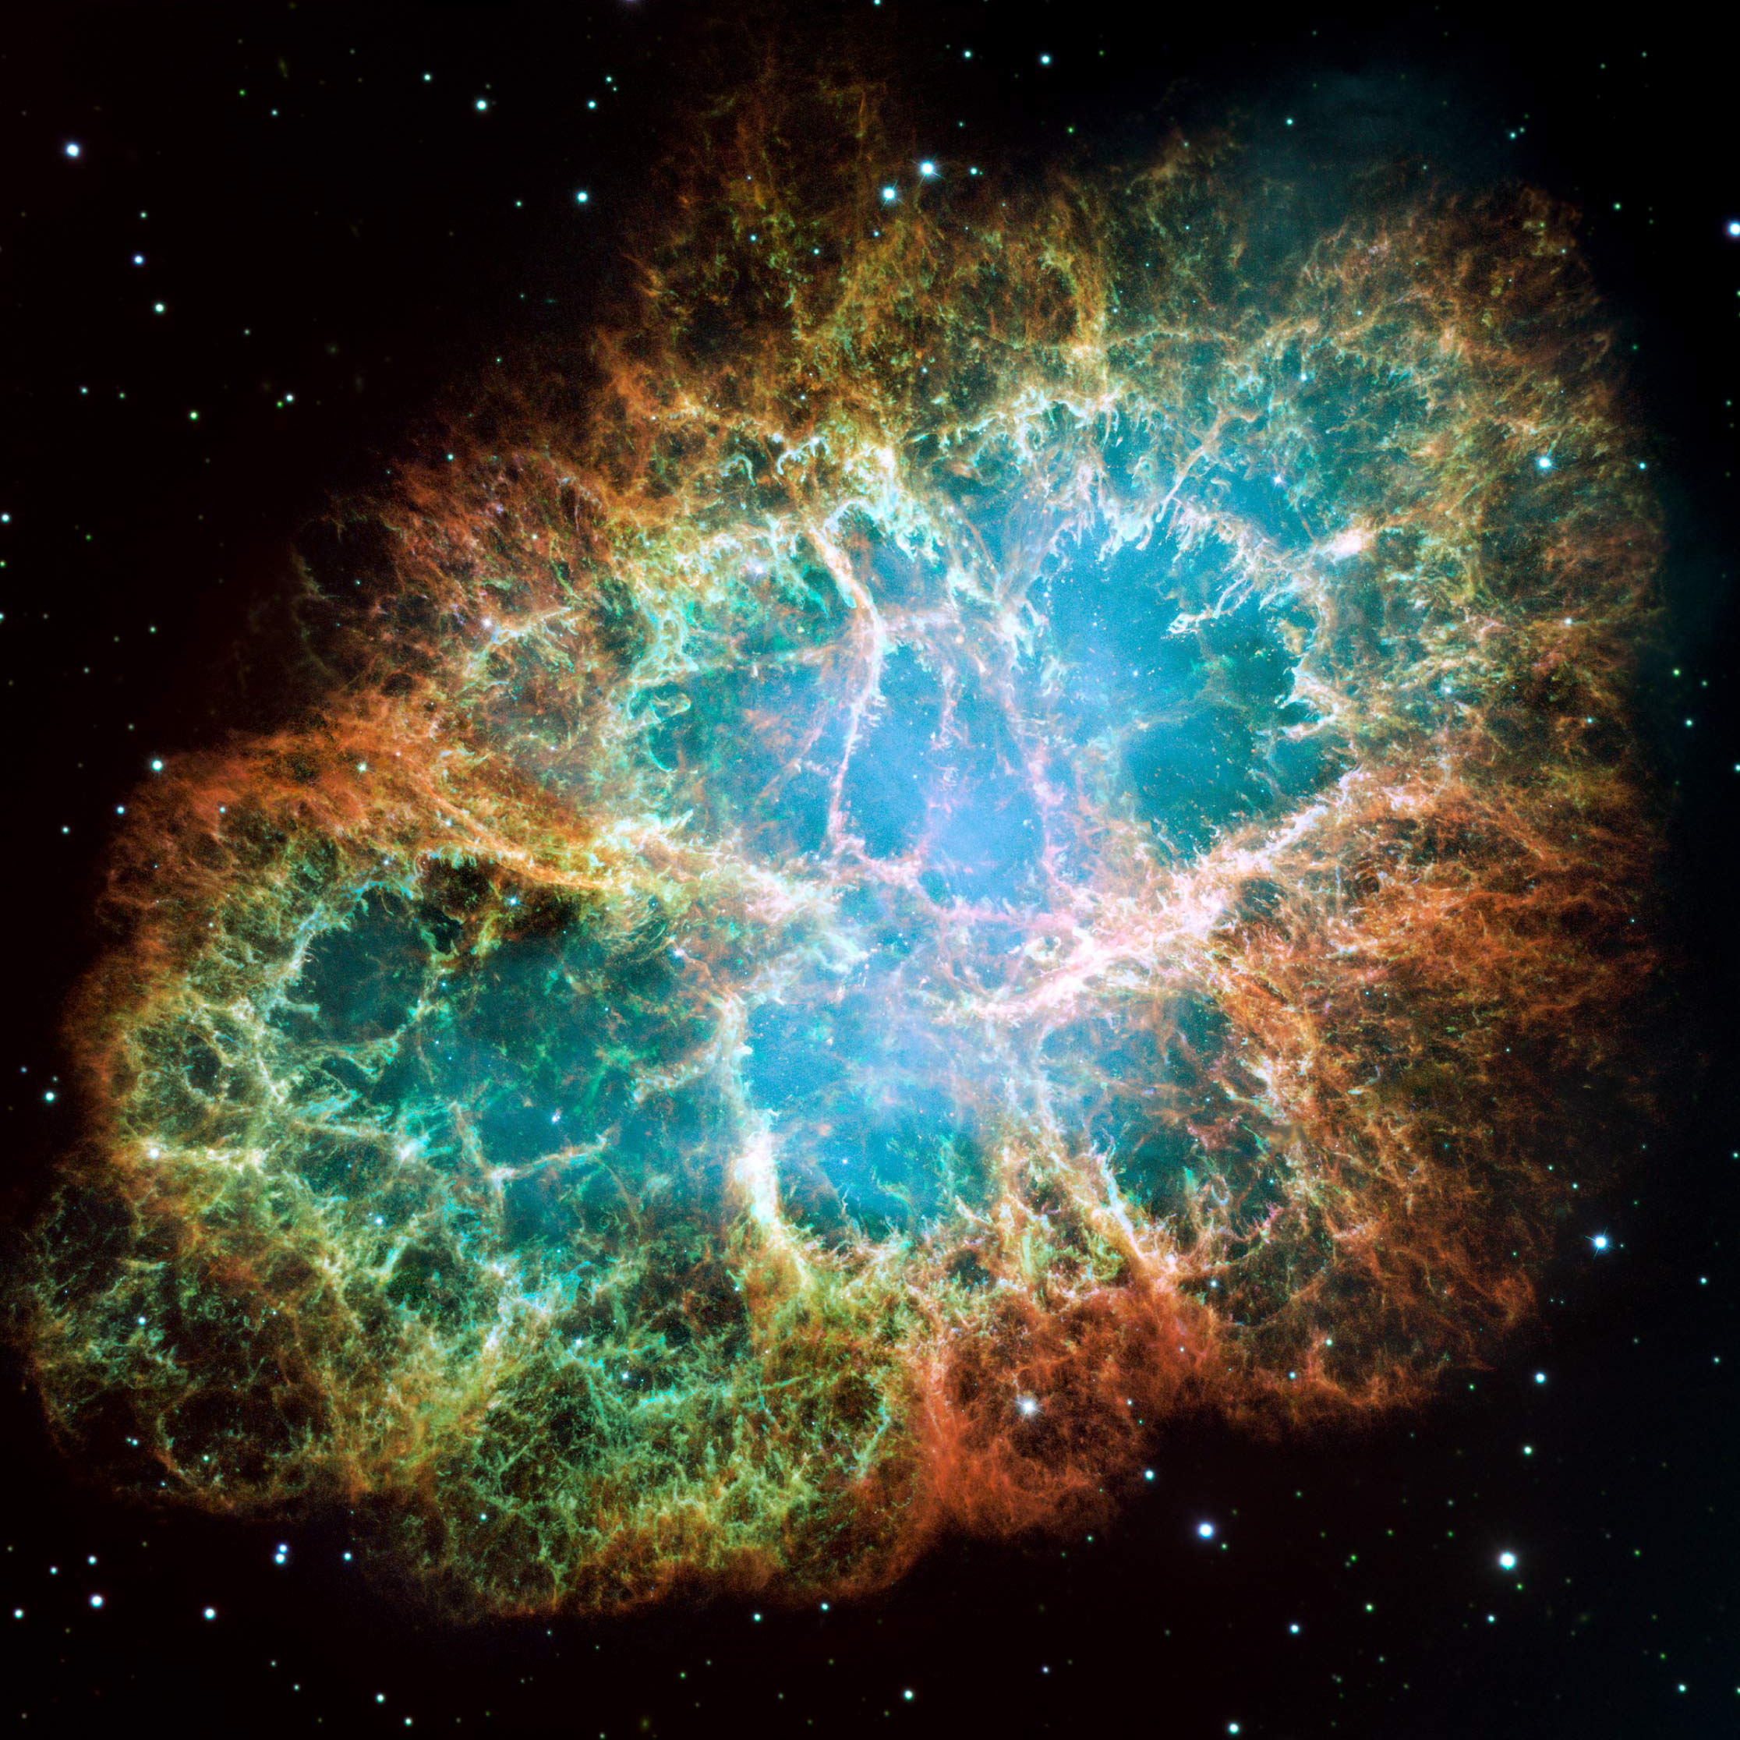
Massive Stars
>8 Solar masses
Short lifetimes (<50 Myr)
Core collapse at end of life can produce supernova
Products: O, Ne, & Mg and beyond
Image credit: NASA
Notes:
Image is of the crab nebula

Slide 4
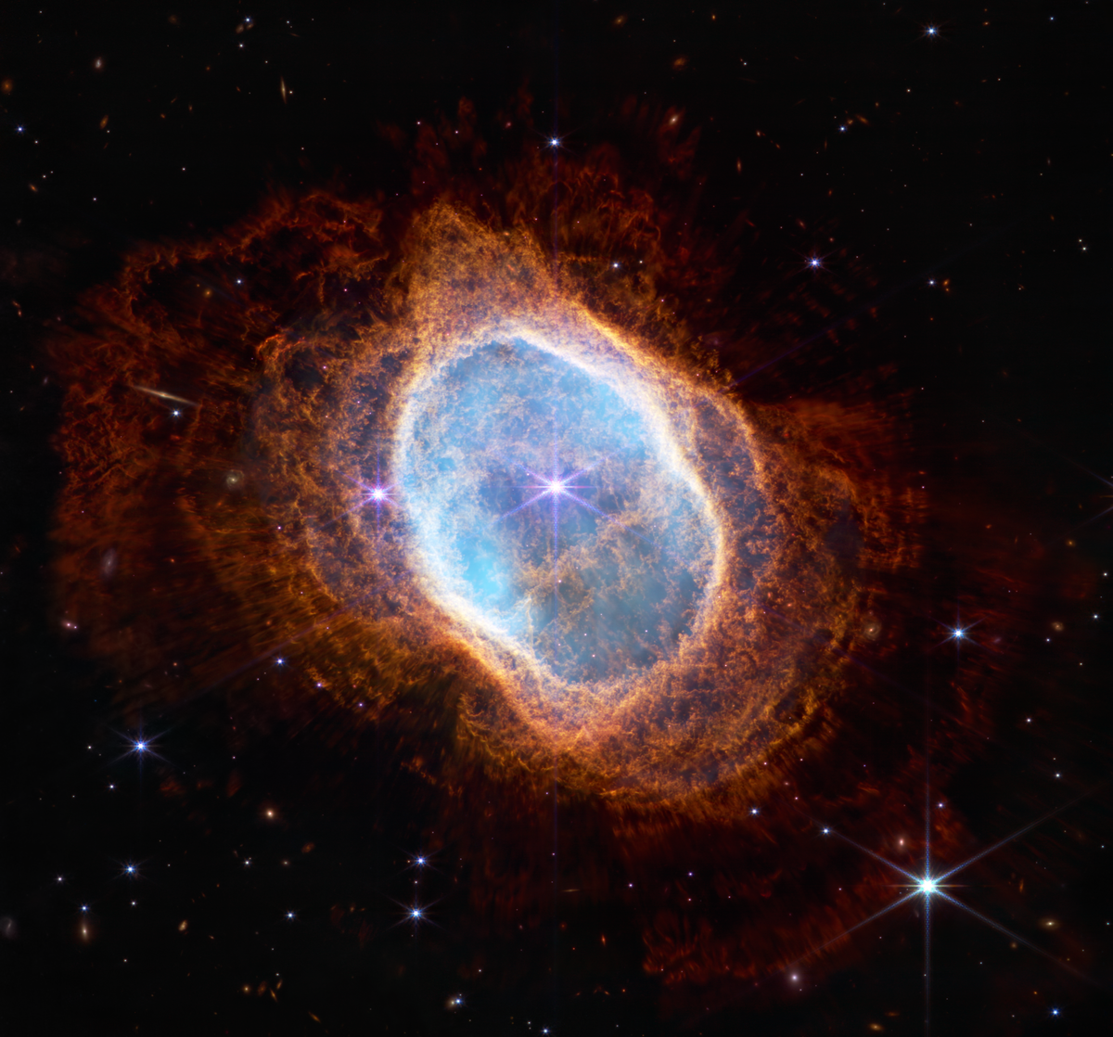
Low Mass Stars
<8 Solar masses
Longer lifetimes (Gyrs)
Eject outer layers and leave behind white dwarf
Products: He, Li, C, N, Sr, Y, Zr, and up
Image credit: NASA
Notes:
Image is of NGC 3132.

Slide 5
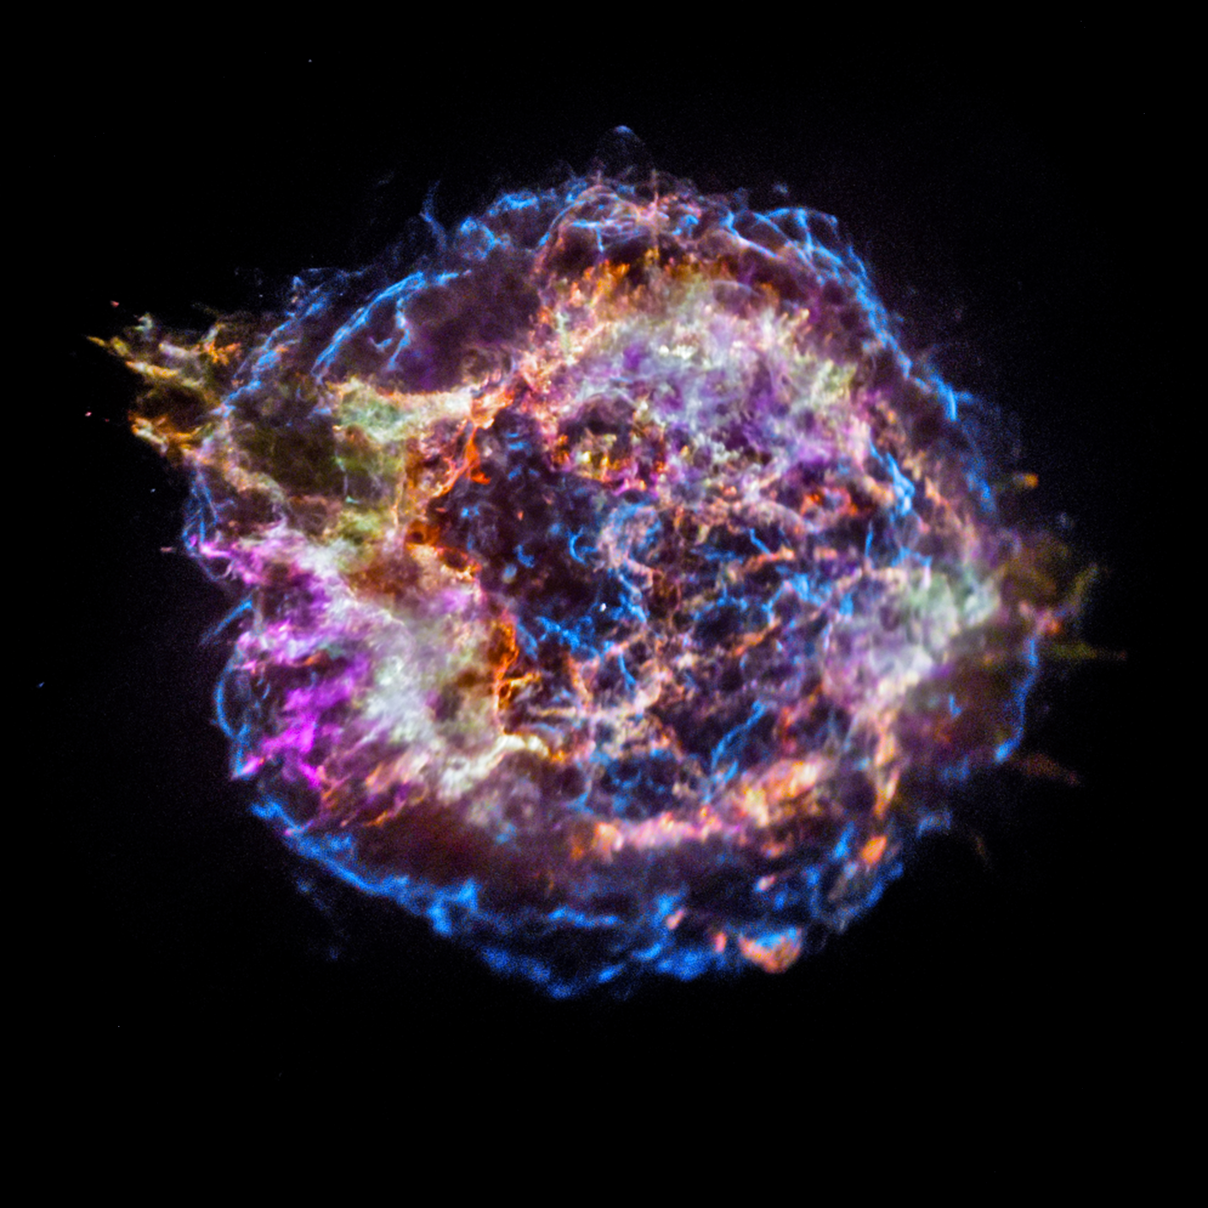
White Dwarf Supernovae
Classically: occurs when WD reaches 1.4 solar masses
Explosion mechanism poorly understood
Products: Ca, Ti, Mn, Fe, Co, Ni, Zn
Image credit: NASA
Notes:
Image is of Cassiopeia A.

Slide 6



Galaxies facilitate nuclear processing
Star Formation
Accretion
Outflows
KABOOM!
Supernovae

Slide 7
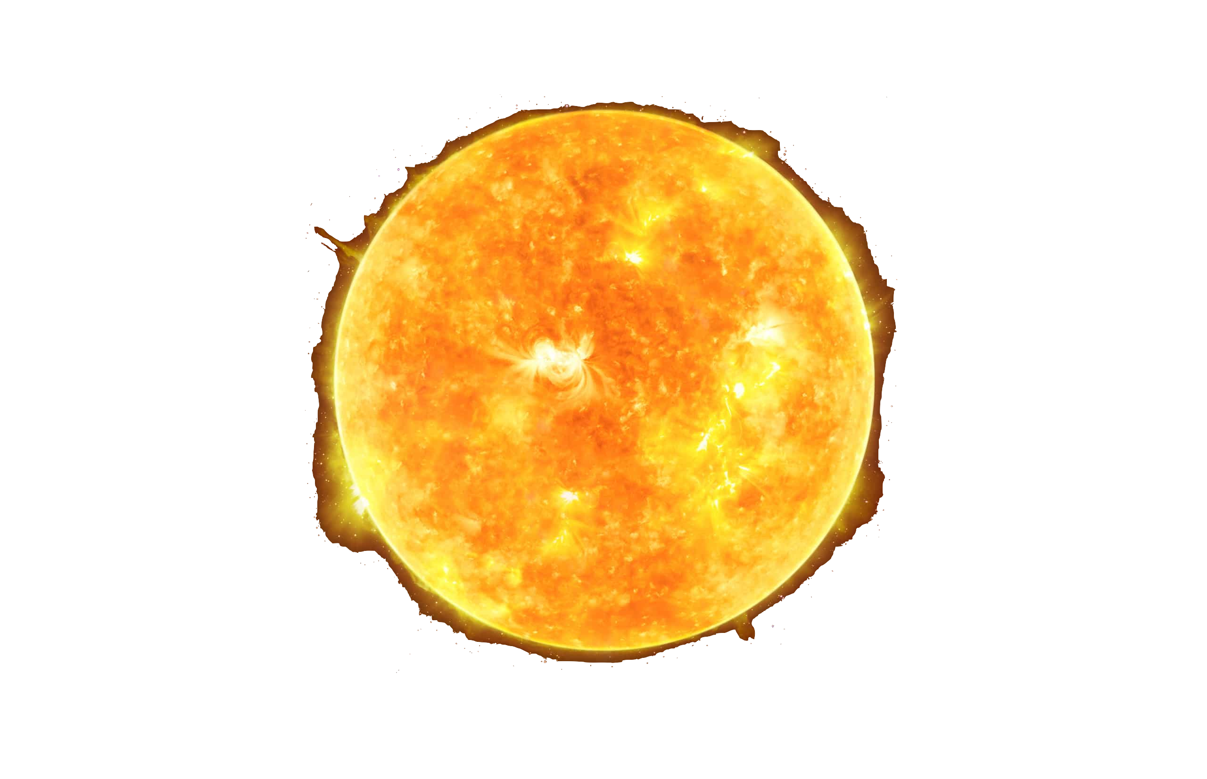

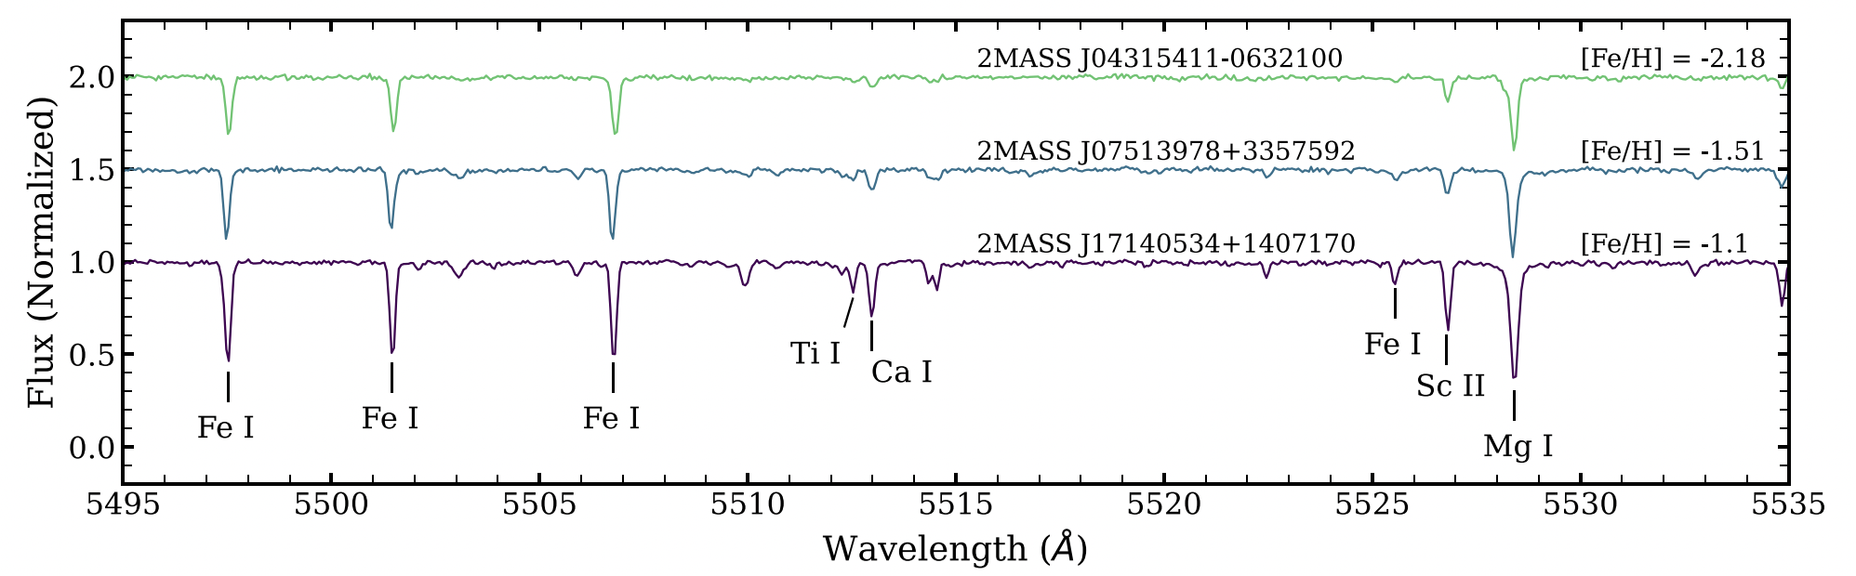
Spectroscopy
How we measure chemical compositions

Slide 8
How to make sense of it all?
Enter galactic chemical evolution models…

Slide 9
One-Zone
Multi-Zone
One chemically homogeneous gas cloud
Multiple clouds
Accretion & Ejection
KABOOM!
KABOOM!
Exchange of Gas & Stars
KABOOM!
New Stars
Metals
KABOOM!

Slide 10


Supernovae (Core Collapse, Type Ia)
Asymptotic Giant Branch stars (low mass)
net production rate = $∑$ sources - $∑$ sinks
Stellar migration
Gas flows
Star Formation
Outflows

Slide 11
What can we learn…
... about the enrichment histories of dwarf galaxies?
... about the impact of stellar migration in the Milky Way?
... from trends with stellar mass?
... about the origin of the elements?

Slide 12
Part 1: Dwarf Galaxies

Slide 13
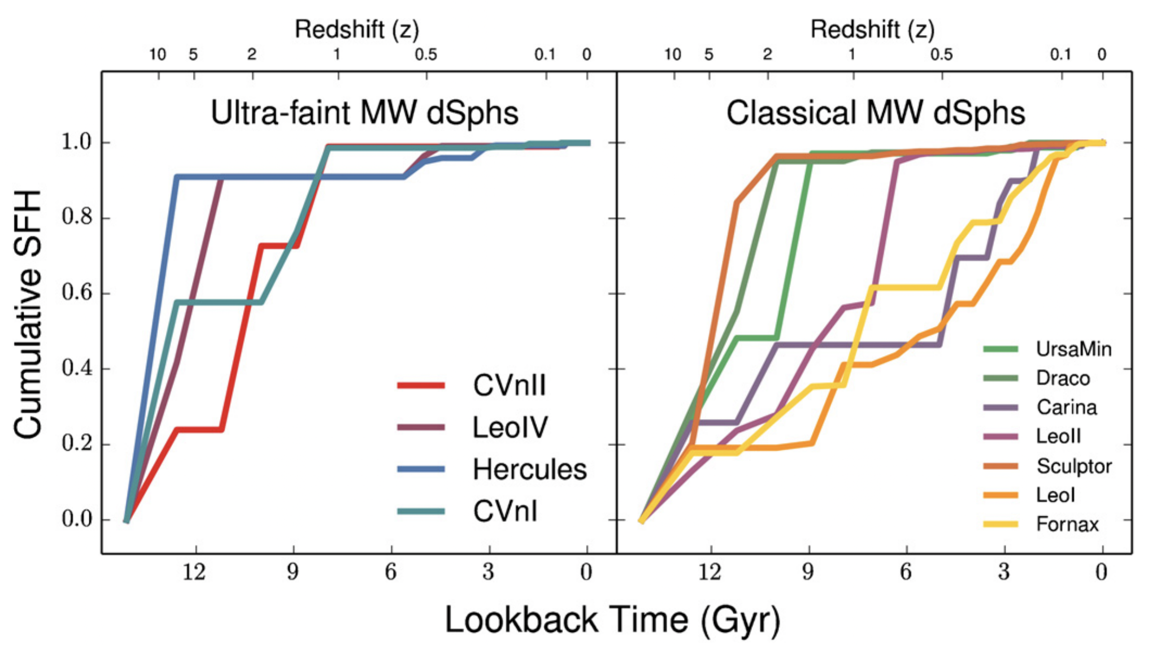
Episodic Star Formation Histories
Weisz et al. (2014), ApJ, 789, 147

Slide 14
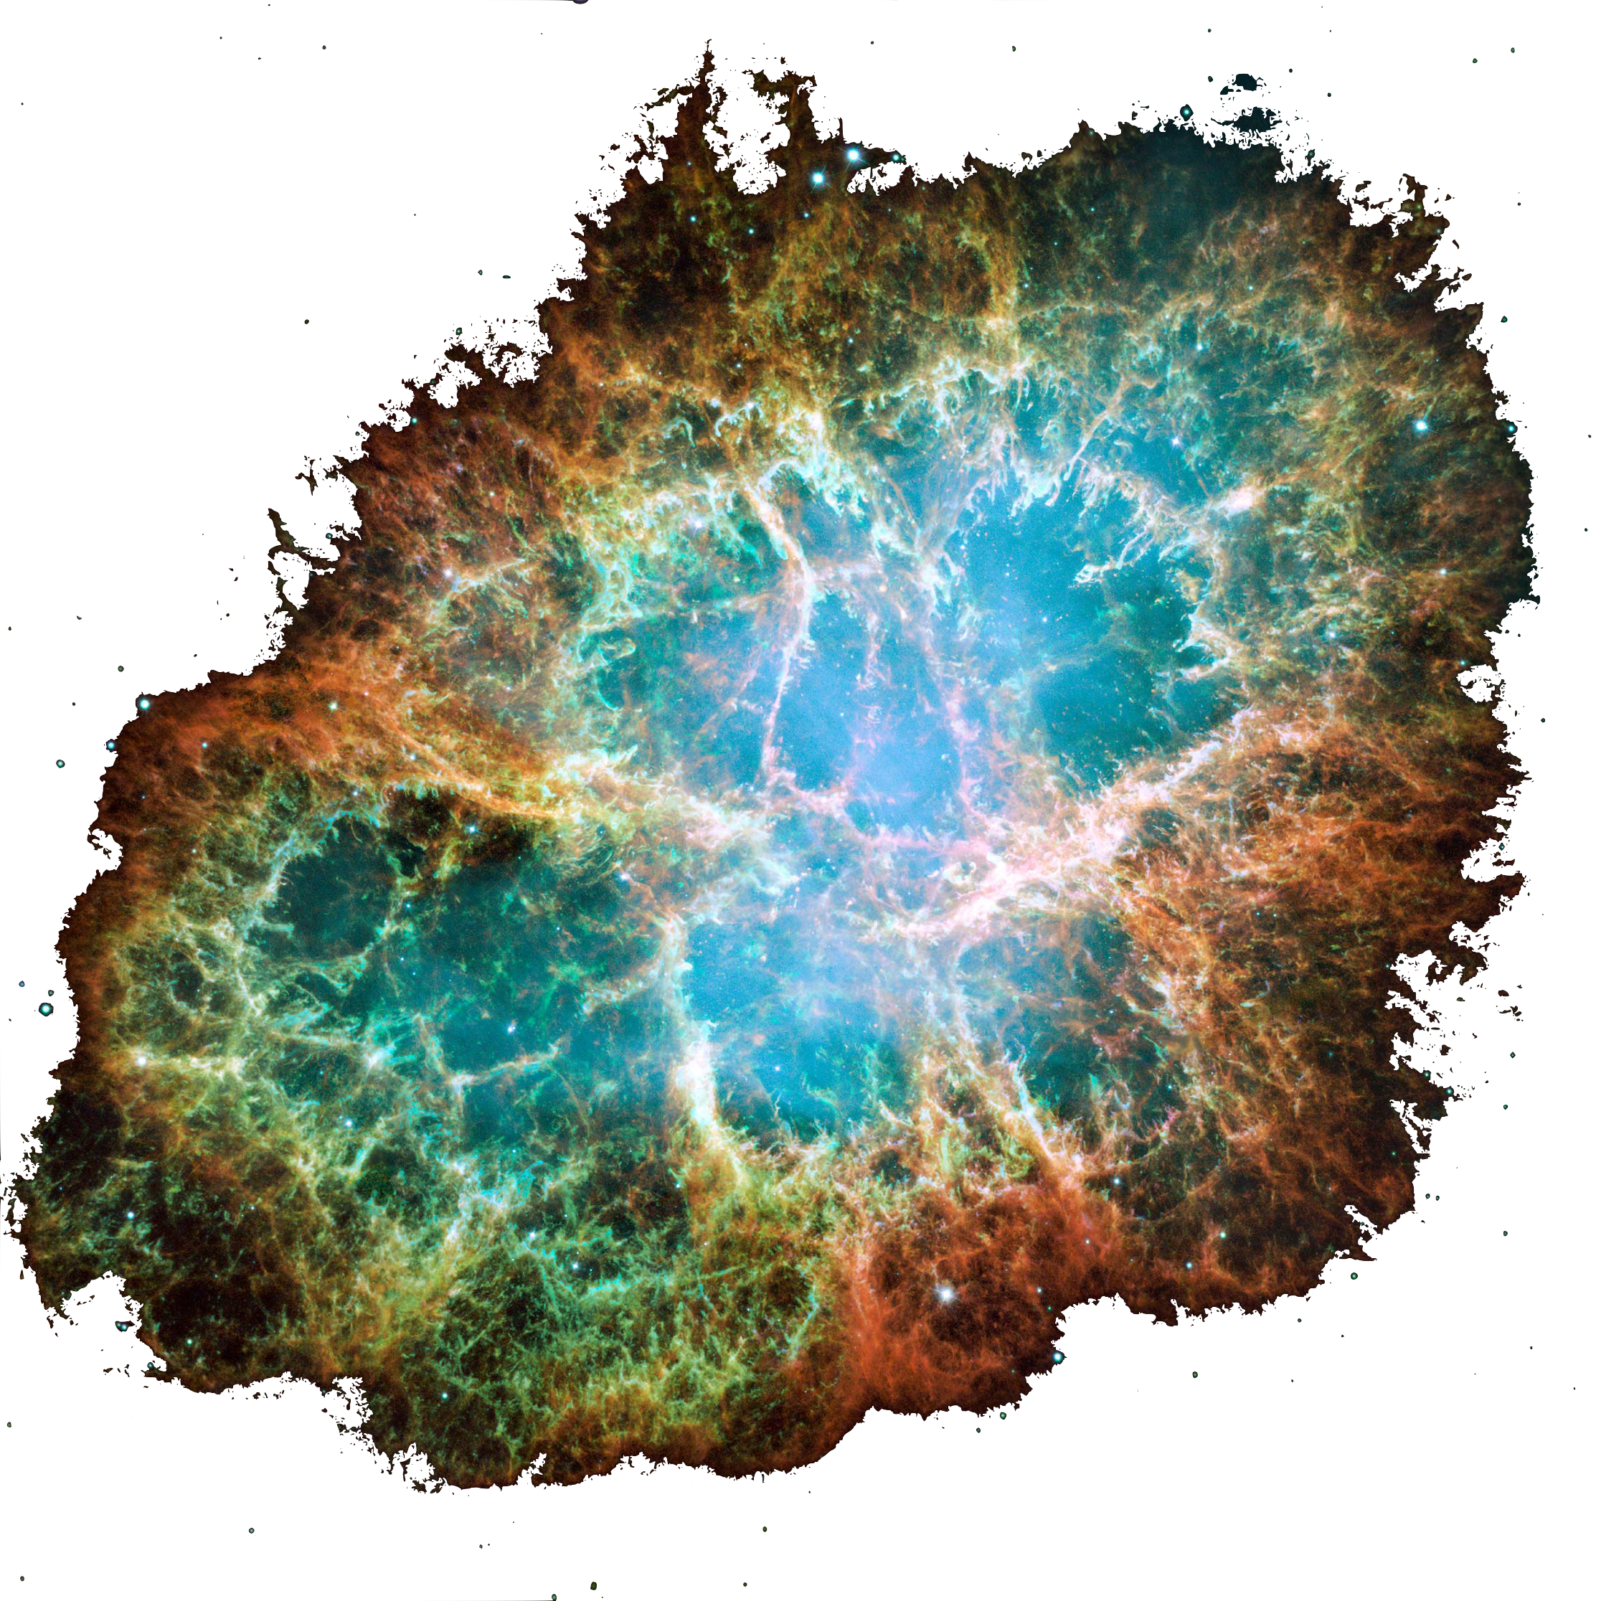
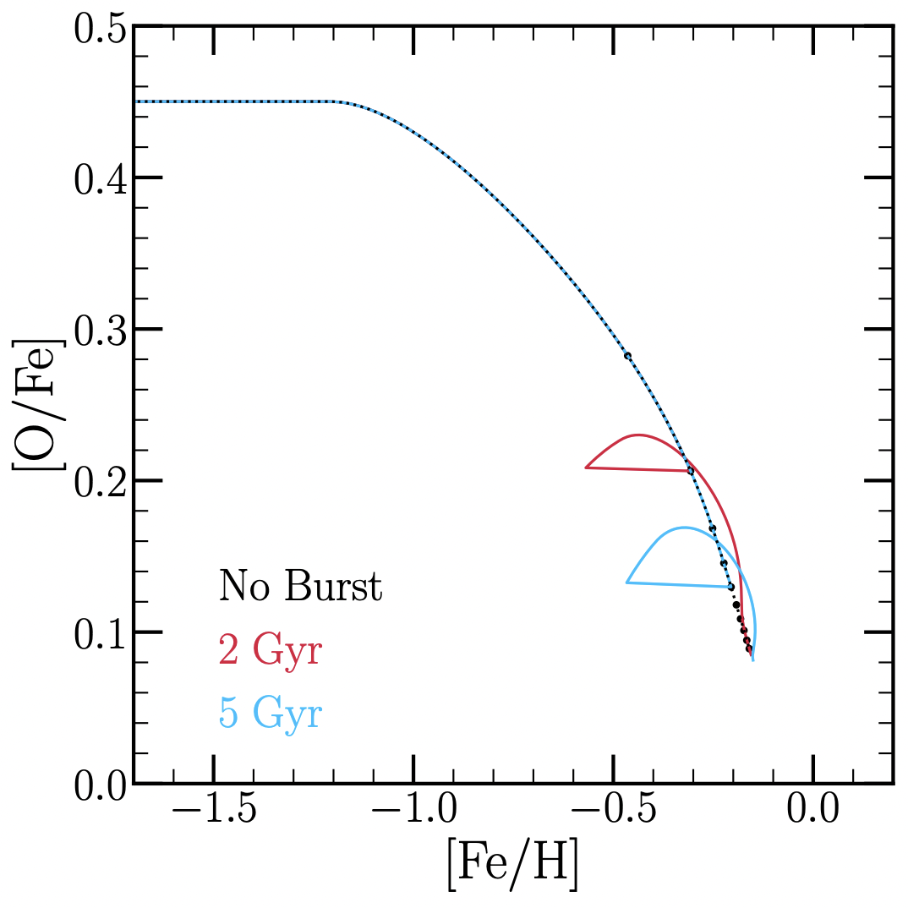
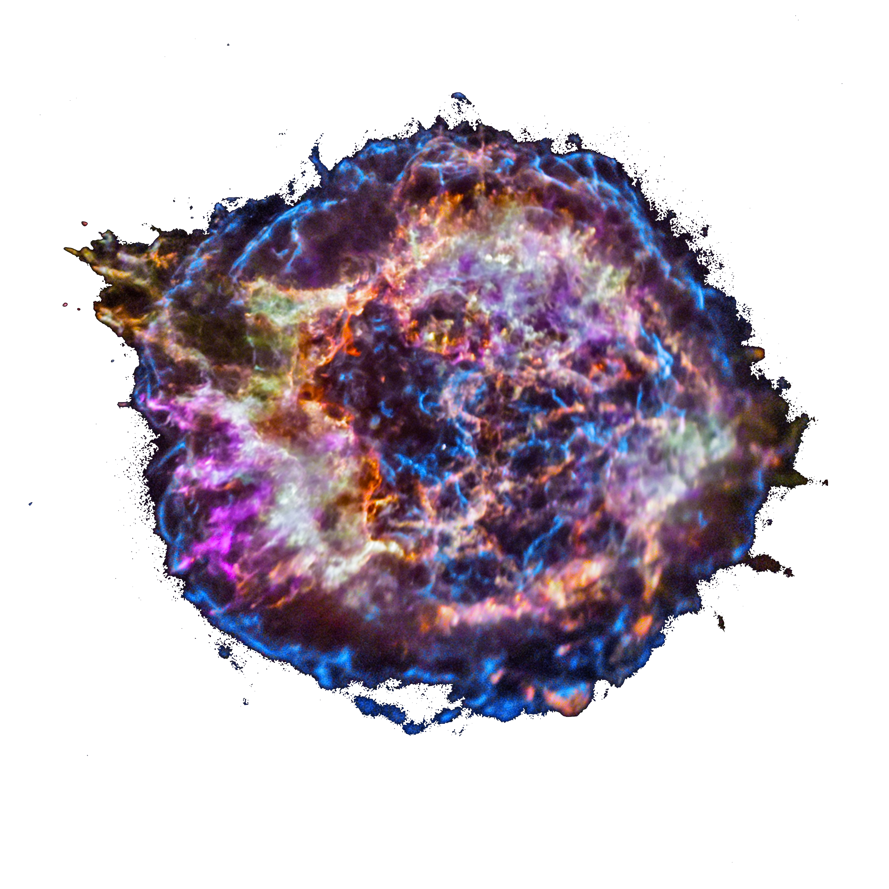
Effect of Accretion-Driven Starburst
Perturbation of corresponding burst-less scenario
Dilution
Enhanced massive star enrichment rate
Enhanced SN Ia rate
Surplus of high [O/Fe] stars
[O/Fe] value depends on timing

Slide 15
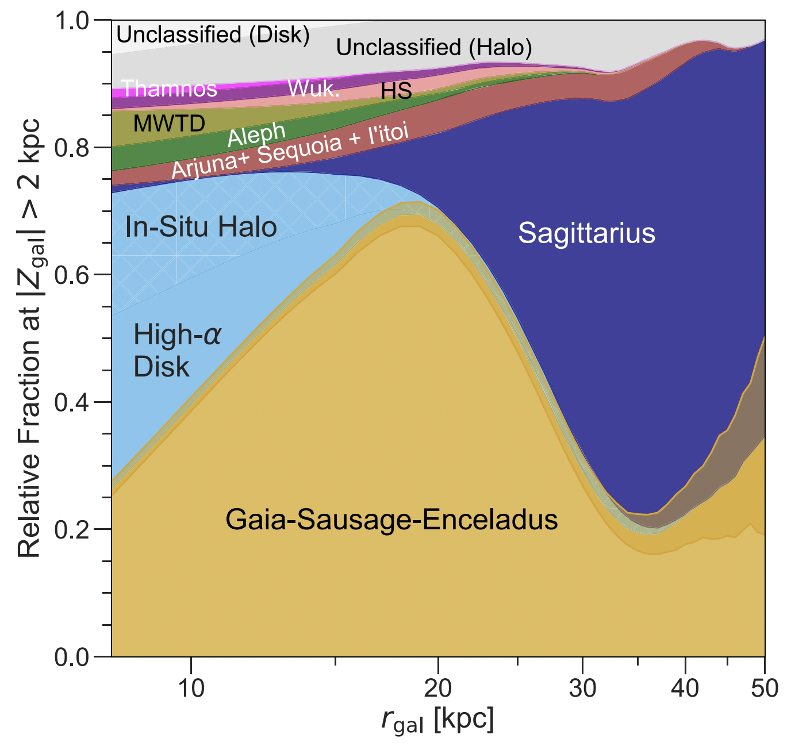
Archaeology of Gaia-Sausage Enceladus
Milky Way’s last major merger
~10 Gyr ago
~10⁹ solar masses
Now quiescent retrograde structure in stellar halo
Naidu et al. (2020), ApJ, 901, 48

Slide 16
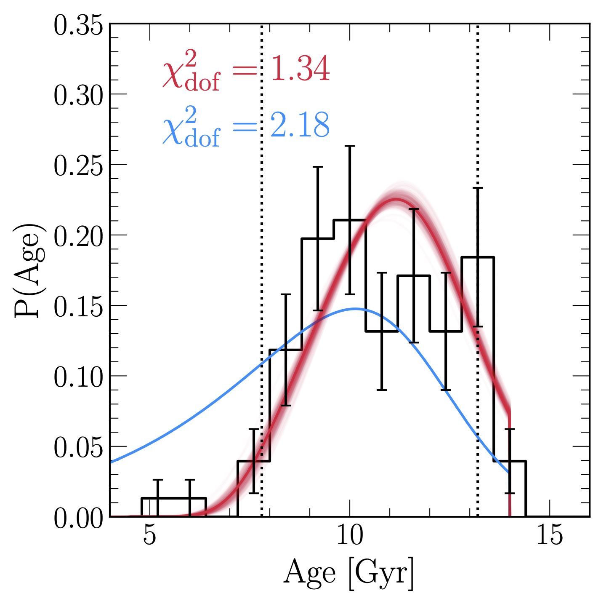
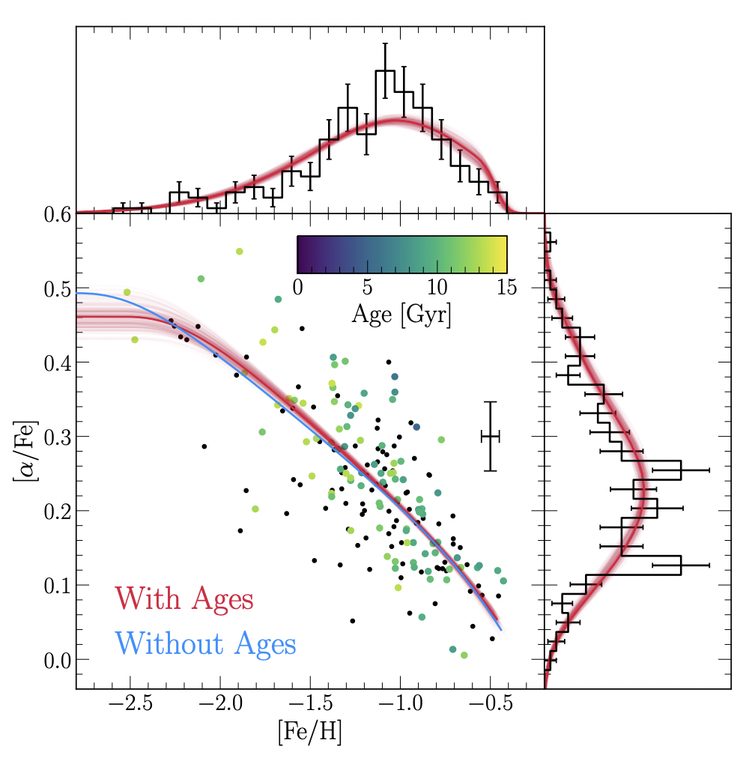
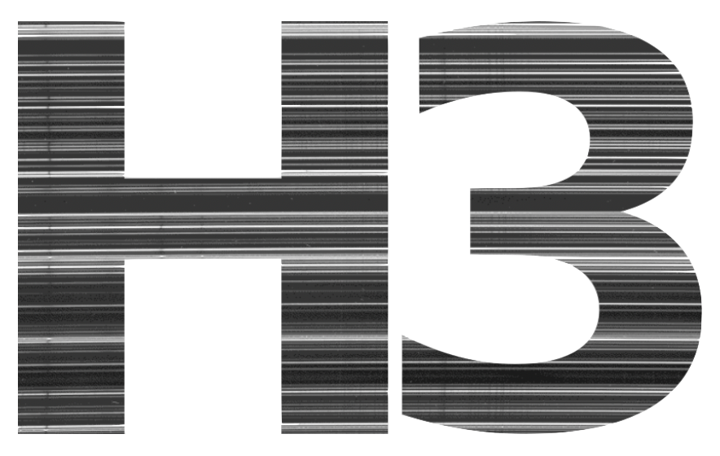
Archaeology of Gaia-Sausage Enceladus
Mg and Fe abundances from H3
Bayesian likelihood estimates based on sampling from curve
Accurately fits N-dimensional distribution in chemical space
Fe yields as free parameters
Accurate stellar age distribution
Requires some measurements
No evidence of starburst
Johnson et al. (2023), submitted to MNRAS

Slide 17

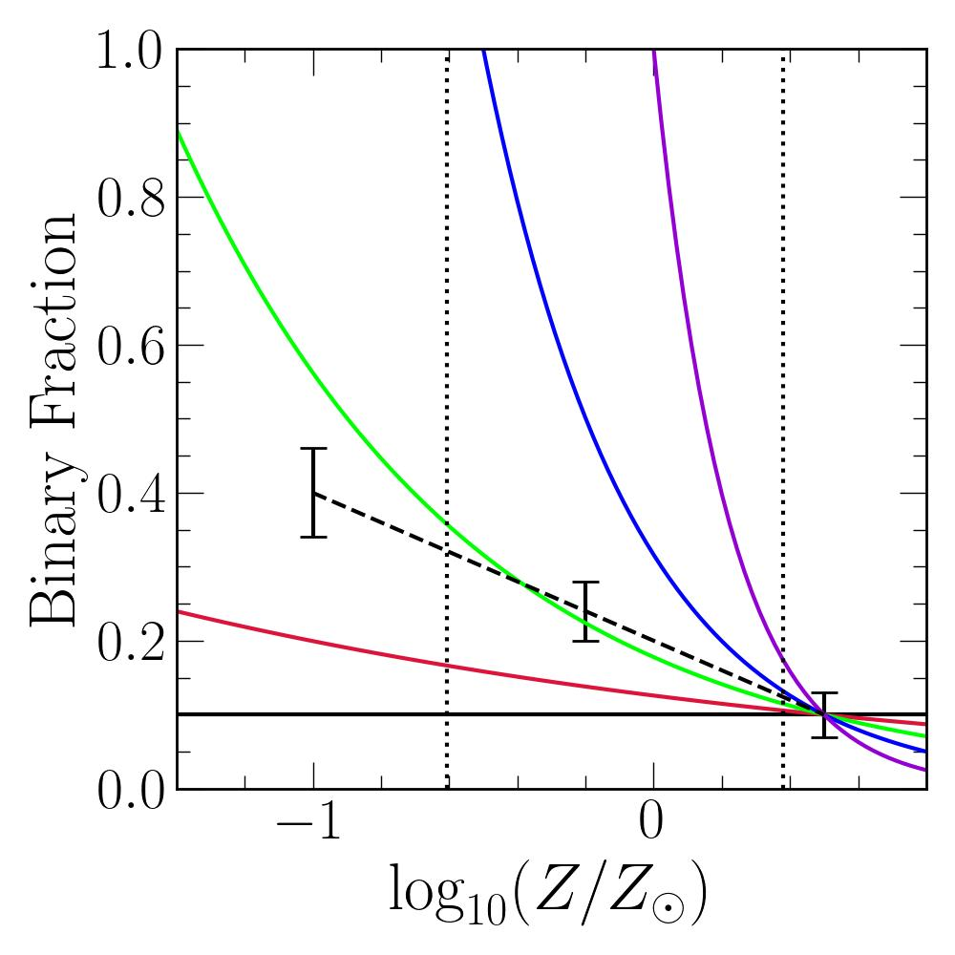
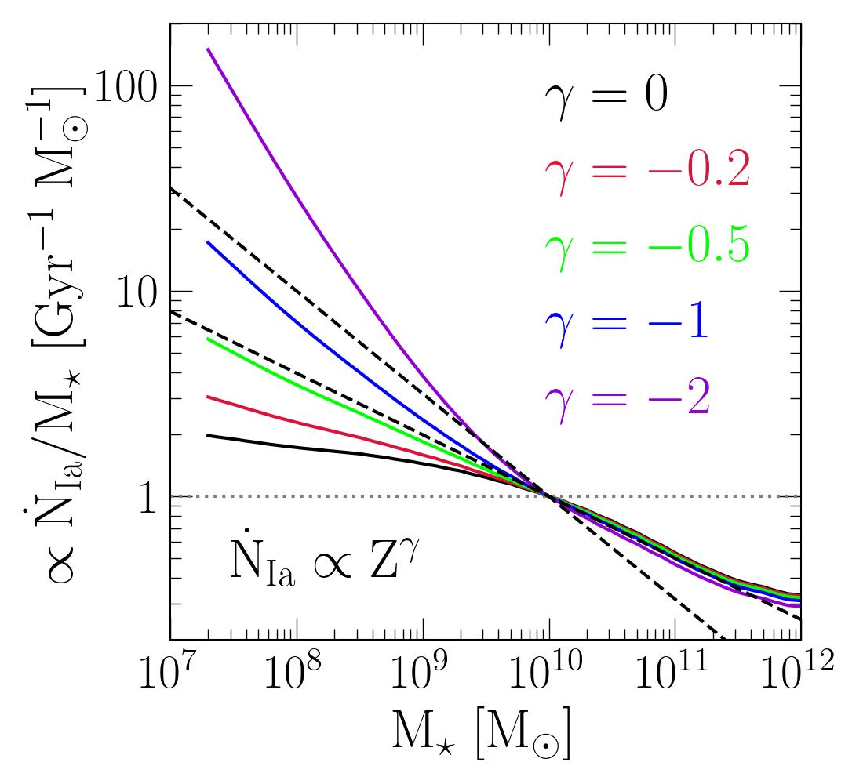
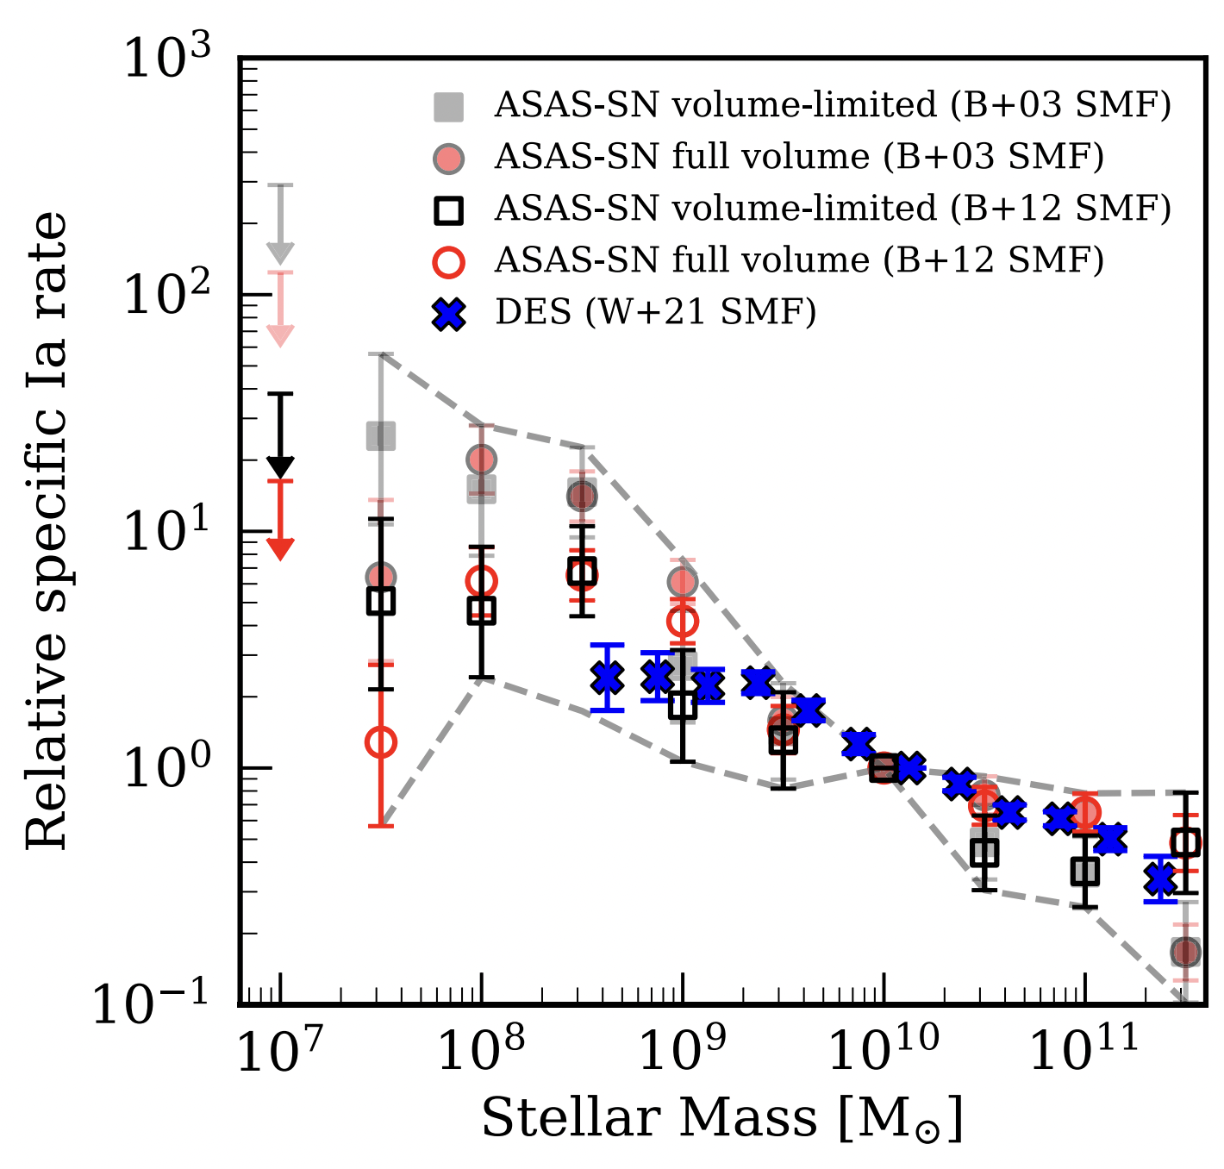
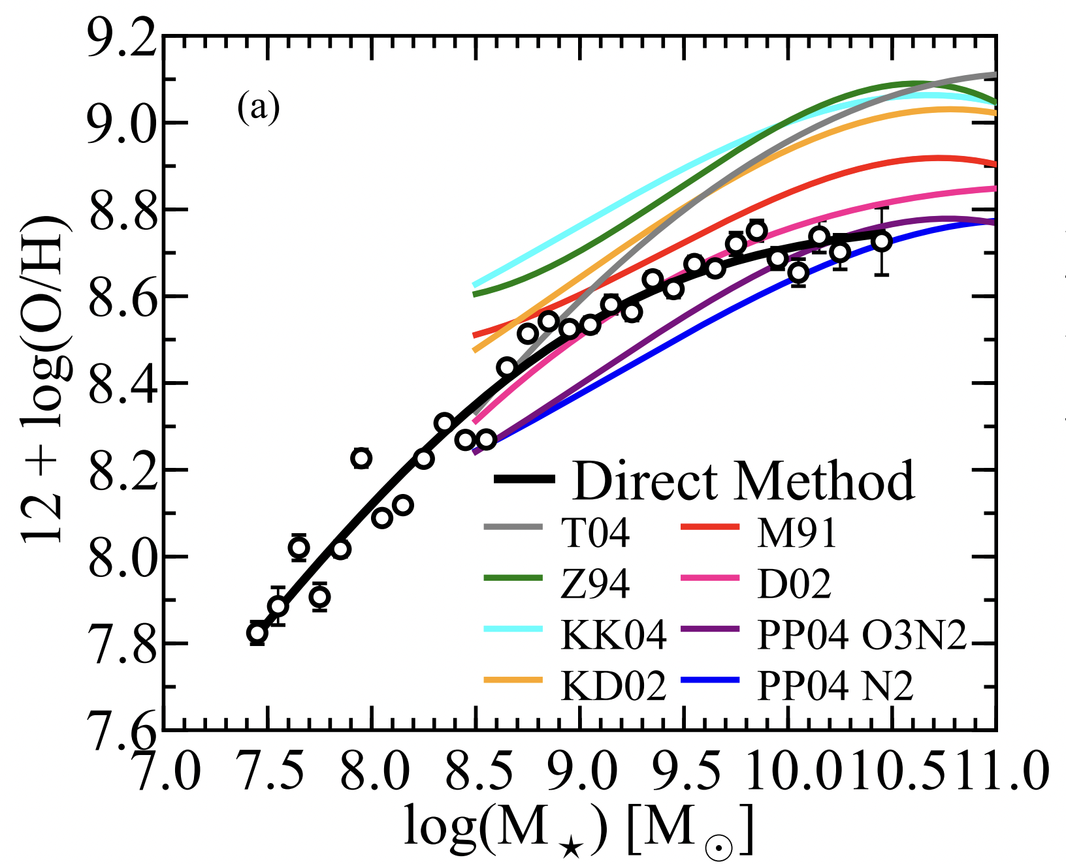

Trends with Stellar Mass
High specific SN Ia rate observed in dwarf galaxies – why?
Strength of trend affected by uncertainties in mass distribution of galaxies
Metallicity: confounding variable
$1/\sqrt{Z}$-dependence fits trend well
Lines up with Z-dependence of close binary fraction
Implications for chemical evolution
Gandhi et al. (2022), MNRAS, 516, 1941
Andrews & Martini (2013), ApJ, 765, 140
Johnson et al. (2023), submitted to MNRAS

Slide 18
Part 2: The Milky Way

Slide 19


What is known empirically?
Inner Galaxy: old & metal-rich
Outer Galaxy: young & metal-poor
Johnson et al. (2023), in prep.

Slide 20
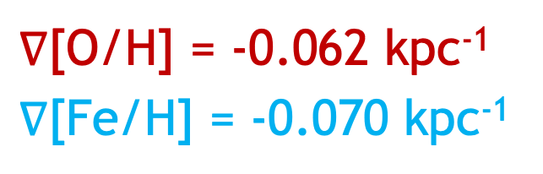
What is known empirically?
$∇$[O/H] = -0.062 kpc⁻¹
$∇$[Fe/H] = -0.070 kpc⁻¹
Metallicity gradient established ~9 Gyr ago
Only small perturbations since then
Johnson et al. (2023), in prep.
Notes:
HII regions: Mendez-Delgado et al. (2023)

Slide 21
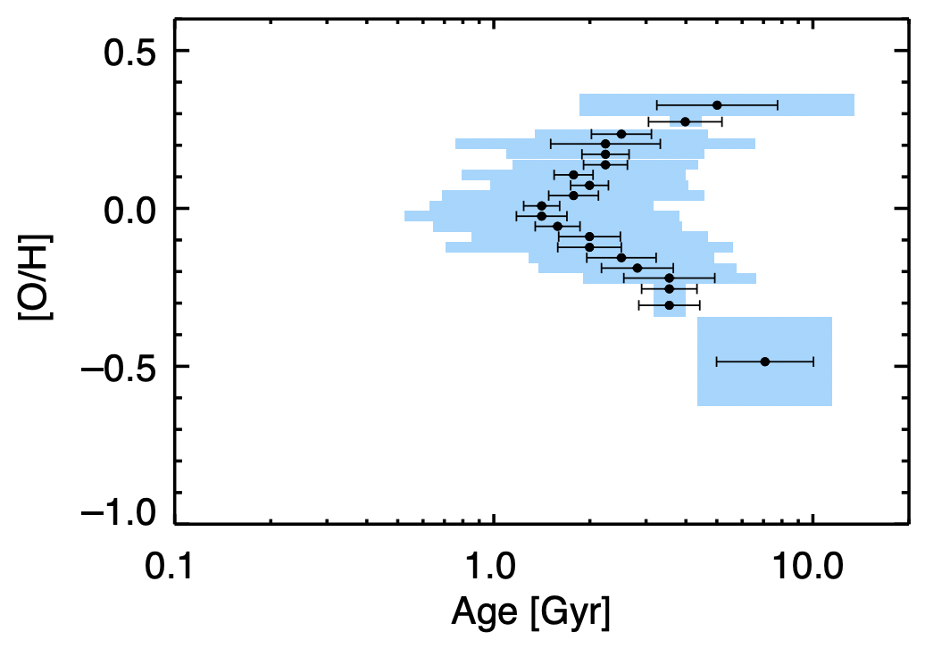
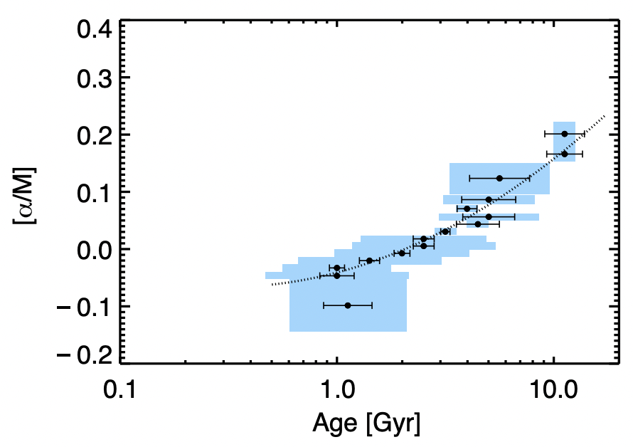
What is known empirically?
Age-metallicity relation is non-monotonic w/considerable scatter
Age-[O/Fe] relation is monotonic w/little scatter
Feuillet et al. (2018), MNRAS, 477, 2326

Slide 22
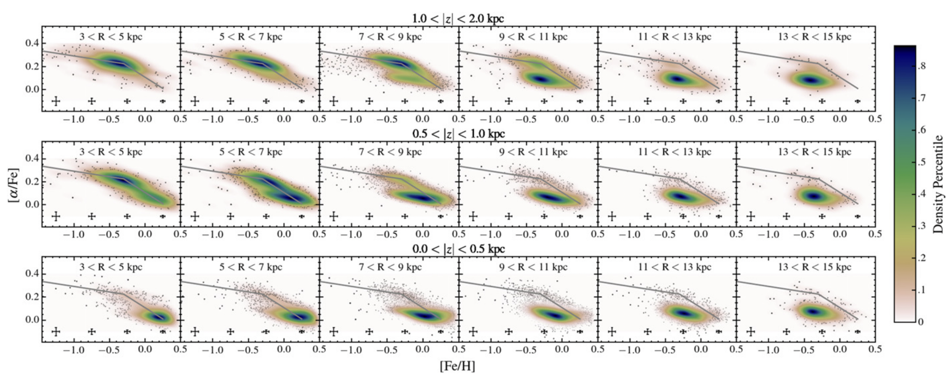
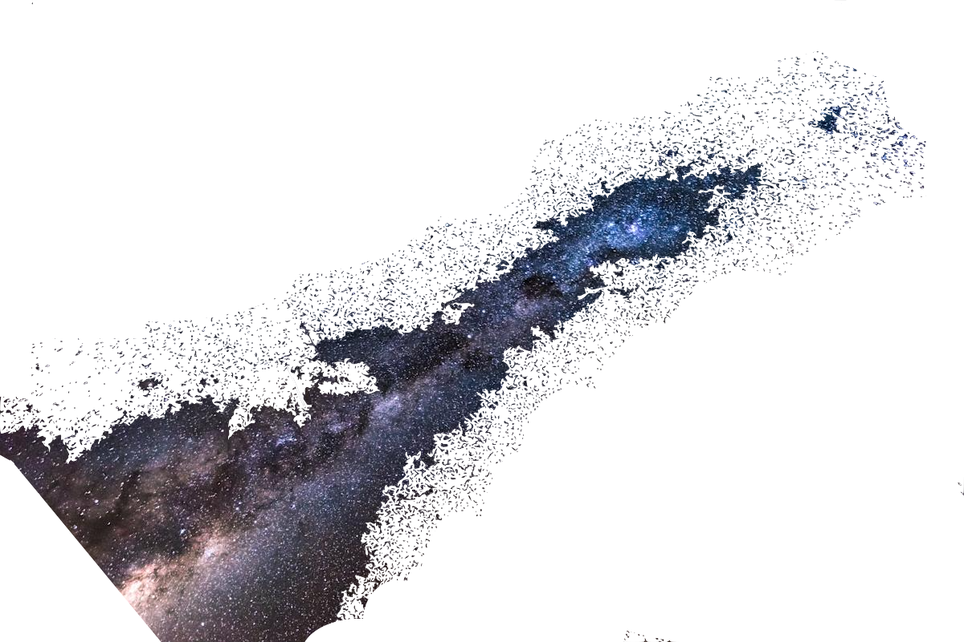
What is known empirically?
The 2-D distribution in alpha and iron-peak elements is bimodal and depends on position in the Galaxy.
Hayden et al. (2015), ApJ, 808, 132

Slide 23
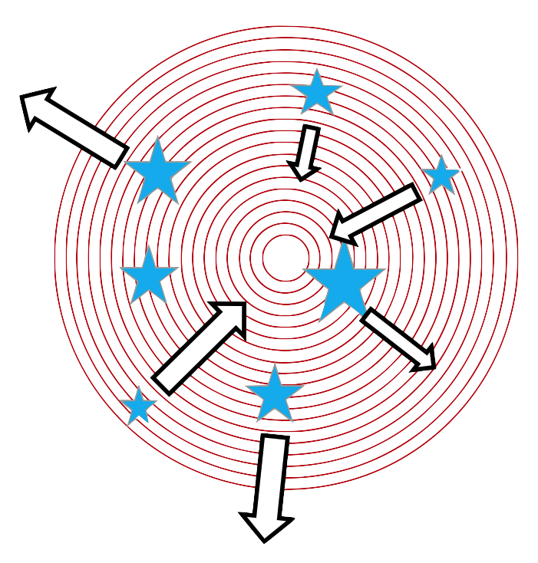
Inside-out disk growth + stellar migration = ?

Slide 24
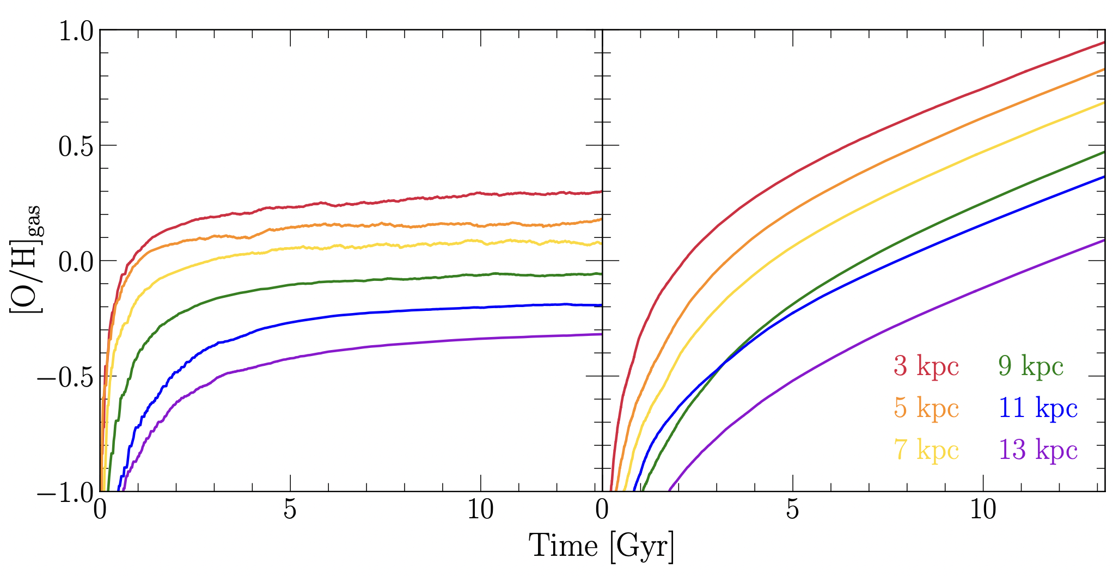
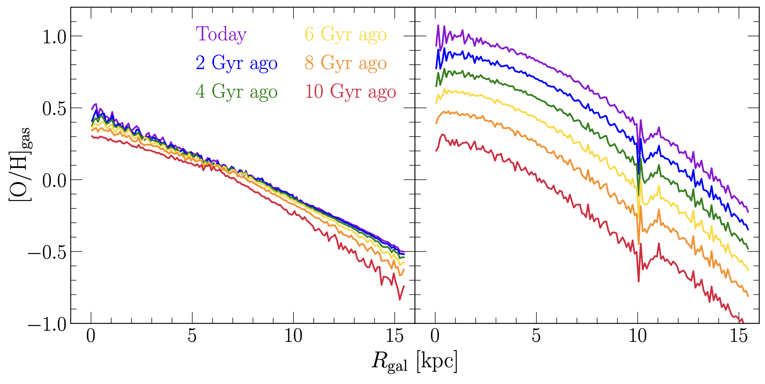
Inside-out disk growth + stellar migration = ?
Metallicity gradient best explained by variations in equilibrium abundance with radius
Johnson et al. (2023), in prep.

Slide 25
Inside-out disk growth + stellar migration = ?
Shape & scatter of age-[O/H] relation well reproduced
Stellar migration plays important role
Age-[O/Fe] as well
Different Galactic regions follow similar trends

Slide 26
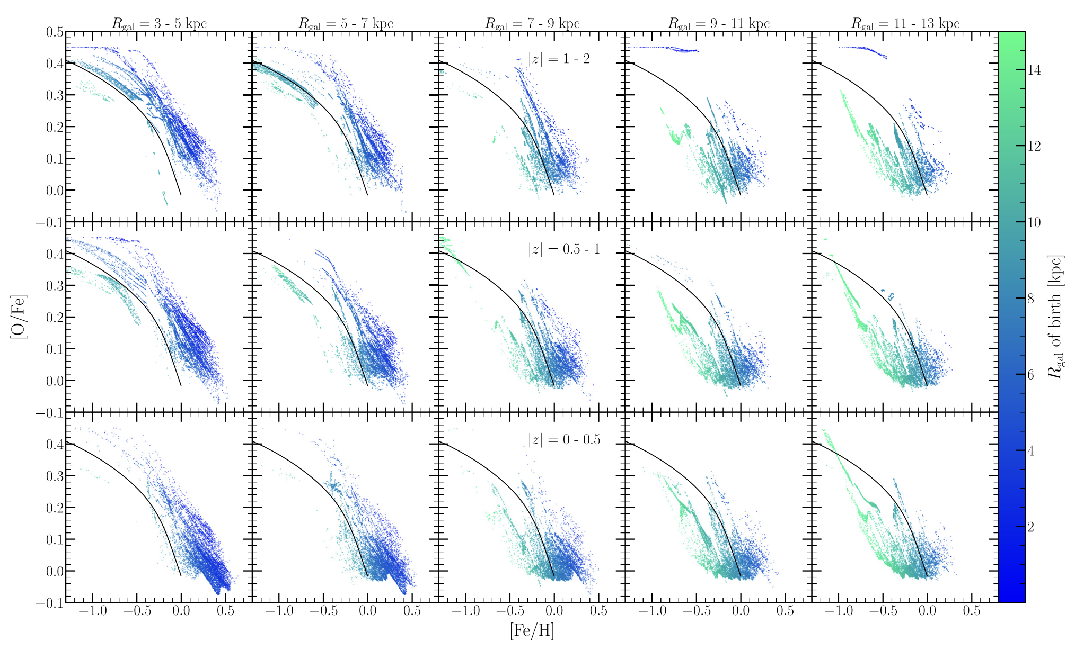
Inside-out disk growth + stellar migration = ?
Bimodality itself is not reproduced, but spatial dependence is
Potentially points to episodic star formation history

Slide 27
Part 3: Nucleosynthesis

Slide 28
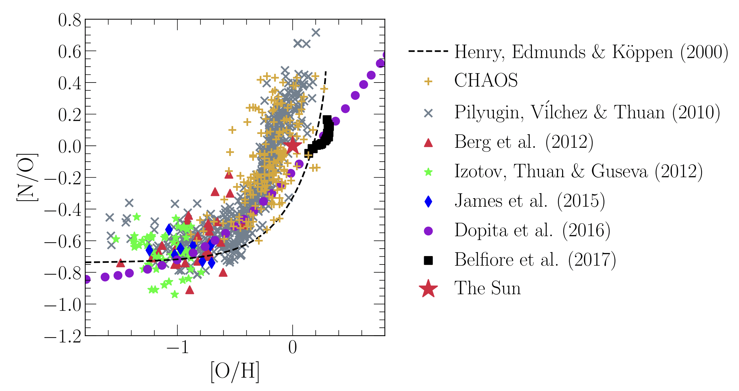
Nitrogen: A Peculiar Element
Seemingly universal relation with oxygen
Nucleosynthetic in origin?
Johnson et al. (2023), MNRAS, 520, 782

Slide 29
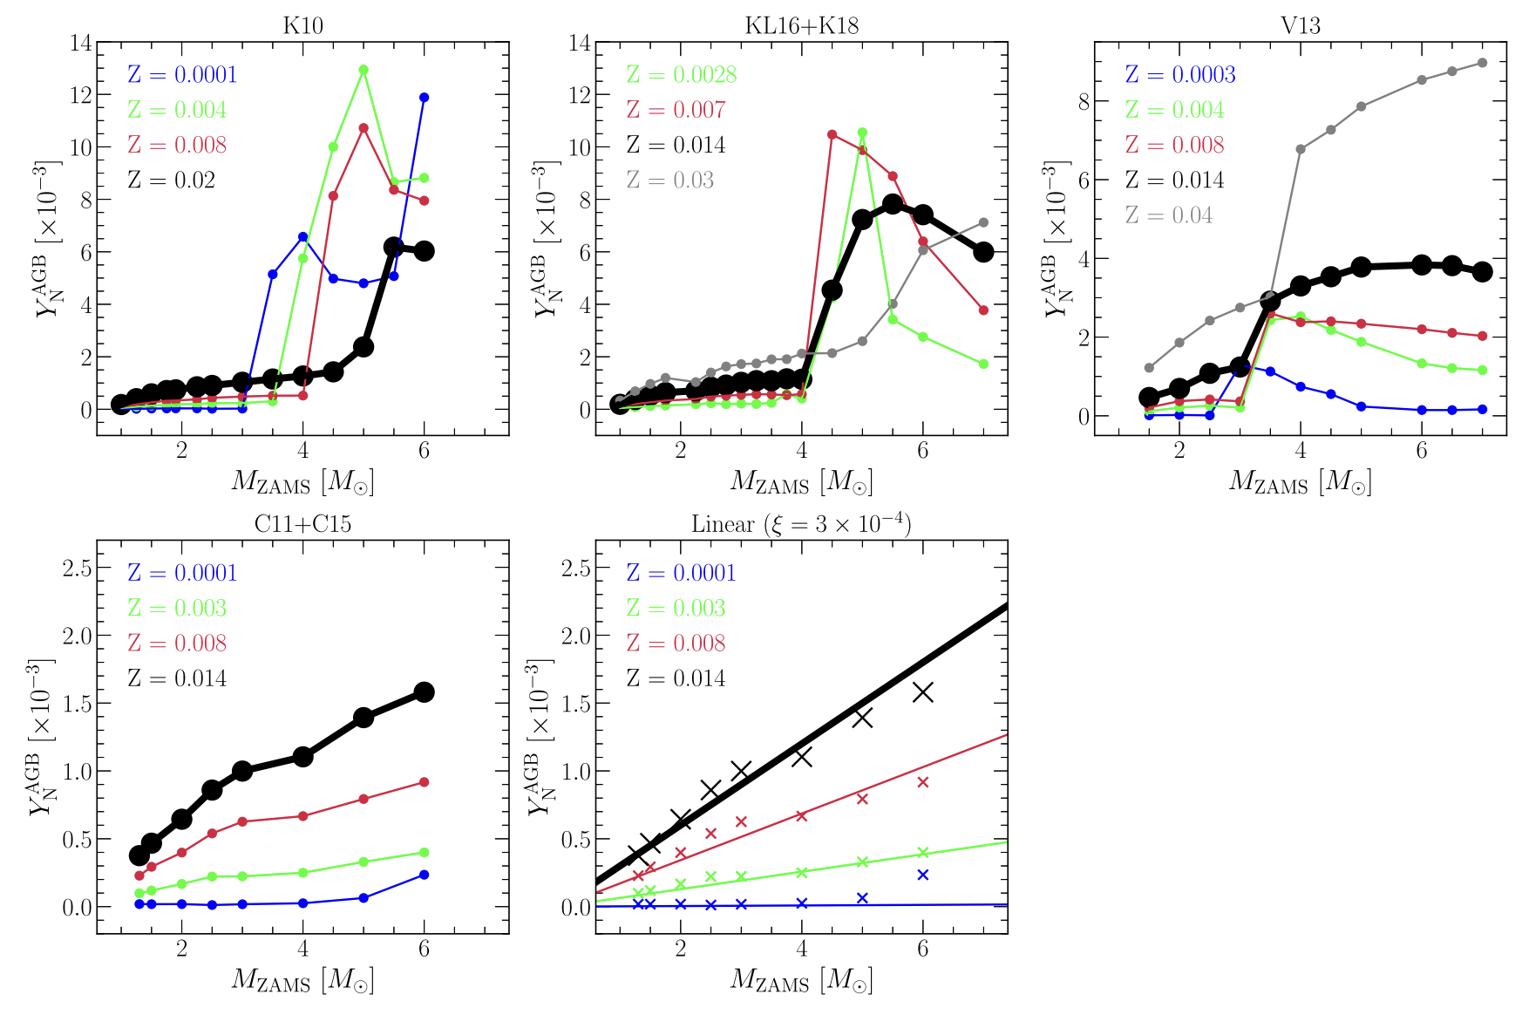
Nitrogen: A Peculiar Element
Yields poorly understood
Sensitive to:
Convection
Rotational mixing
Mass loss
Johnson et al. (2023), MNRAS, 520, 782

Slide 30
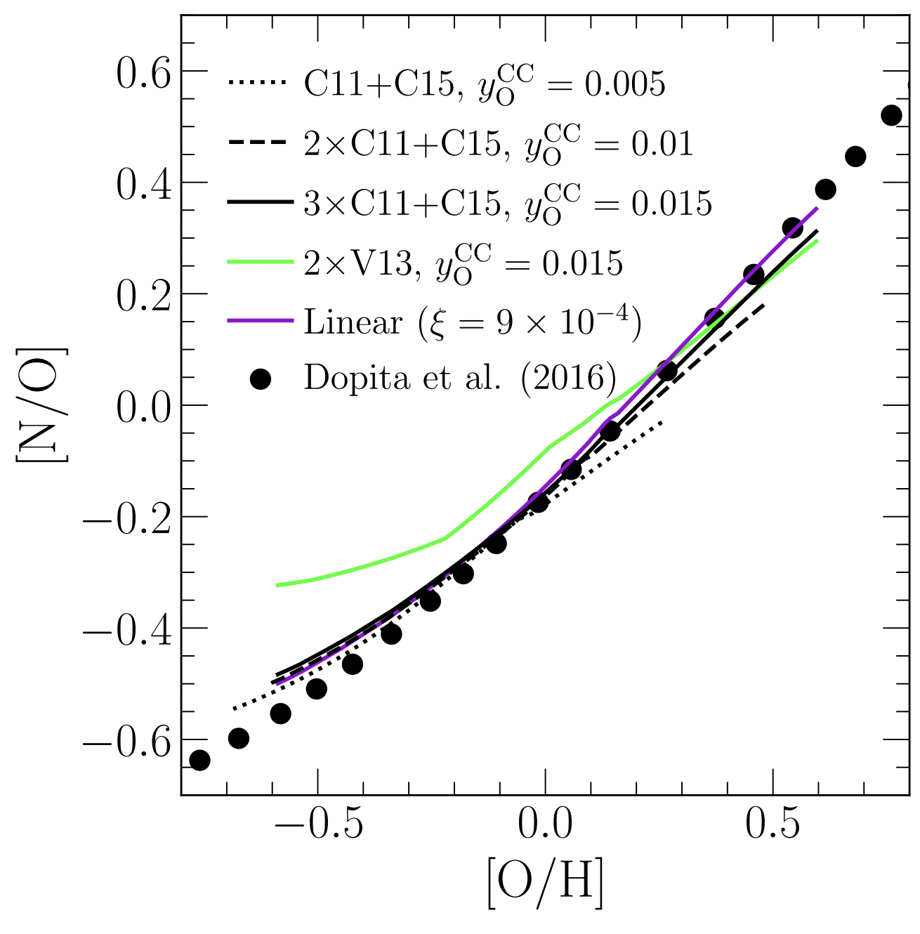
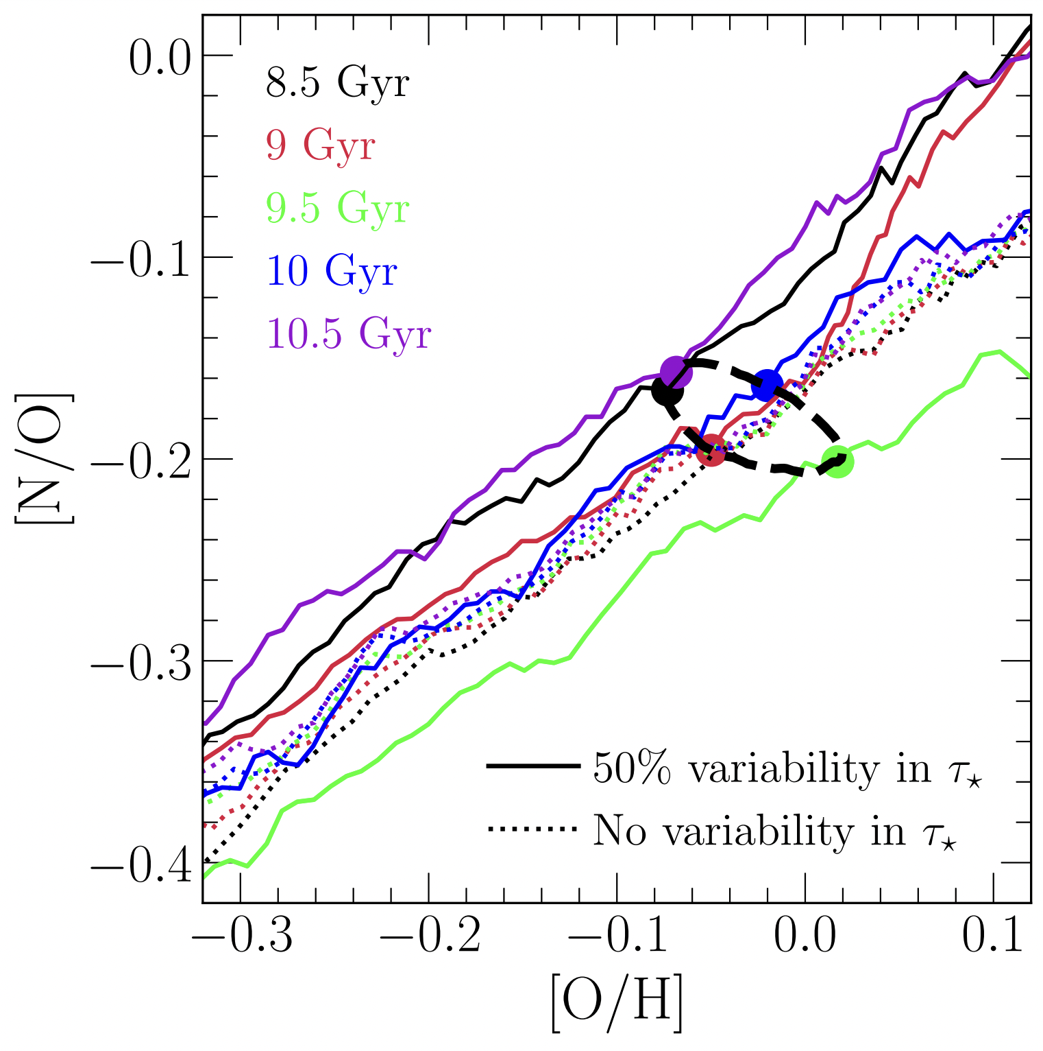

Nitrogen: A Peculiar Element
[N/O]-[O/H] relation reproduced as long as $$\frac{y_{N}}{y_{O}}≈0.024+0.062 \left(\frac{Z}{Z_{⊙}}\right)$$
Variations in SFH induce scatter
Important implications for stellar evolution
See also Gil-Pons et al. (2022)
Johnson et al. (2023), MNRAS, 520, 782

Slide 31
Conclusions
No evidence of burst in star formation in Gaia-Sausage Enceladus
Metallicity dependence of the binary star fraction lends natural explanation to variations in specific SN Ia rate with galaxy mass
Milky Way abundance structure best explained by variations in equilibrium with radius combined with stellar migration
Room for improvement: episodic SFH
Nitrogen yields should scale linearly with Z above some minimum

Slide 32

Versatile Integrator for Chemical Evolution
Workhorse for integrating models
Input: Galaxy evolution parameters
Star formation history
Gas and star exchange
Stellar yields
Output: Elemental abundances
Gas at all timesteps in all zones
Every stellar population

